Slide 1
8051 MICROCONTROLLER Interrupt, Timer AND Addressing Modes
Farhan Sadaf
Lecturer, Dept. of CSE

Slide 2
Interrupt Structure
An interrupt is an external or internal event that disturbs the microcontroller to inform it that a device needs its service.
The program which is associated with the interrupt is called the interrupt service routine (ISR) or interrupt handler.
Upon receiving the interrupt signal, the Microcontroller finish current instruction and saves the PC on stack.
Jumps to a fixed location in memory depending on type of interrupt starts to execute the interrupt service routine until RETI (return from interrupt).

Slide 3
Interrupt Structure
After executing the RETI the microcontroller returns to the place where it was interrupted.
The 8051 microcontroller has FIVE interrupts in addition to Reset. They are :
Timer 0 overflow Interrupt
Timer 1 overflow Interrupt
External Interrupt 0 (INT0)
External Interrupt 1 (INT1)
Serial port events Interrupt.

Slide 4
Interrupt Structure
Each interrupt has a specific place in code memory where program execution (interrupt service routine) begins.
External Interrupt 0: 0003 H
Timer 0 overflow: 000B H
External Interrupt 1: 0013 H
Timer 1 overflow: 001B H
Serial Interrupt : 0023 H
Upon reset all Interrupts are disabled & do not respond to the Microcontroller. These interrupts must be enabled by software in order for the Microcontroller to respond to them.
This is done by an 8-bit register called Interrupt Enable Register (IE).

Slide 5

Interrupt Enable Register
EA : Global enable/disable. To enable the interrupts this bit must be set High.
--- : Undefined-reserved for future use.
ET2 : Enable /disable Timer 2 overflow interrupt.
ES : Enable/disable Serial port interrupt.
ET1 : Enable /disable Timer 1 overflow interrupt.
EX1 : Enable/disable External interrupt1.
ET0 : Enable /disable Timer 0 overflow interrupt.
EX0 : Enable/disable External interrupt0

Slide 6
Interrupt Structure Priority
Upon reset the interrupts have the following priority. (Top to down). The interrupt with the highest PRIORITY gets serviced first.
External interrupt 0 (INT0)
Timer interrupt 0 (TF0)
External interrupt 1 (INT1)
Timer interrupt 1 (TF1)
Serial interrupt (RI+TI)

Slide 7

Interrupt priority register
IP.7 and IP.6: reserved
IP.5: Timer 2 interrupt priority bit
IP.4: Serial port interrupt priority bit
IP.3: Timer 1 interrupt priority bit
IP.2: External interrupt 1 priority bit
IP.1: Timer 0 interrupt priority bit
IP.0: External interrupt 0 priority bit

Slide 8
Interrupt (From book)
Time Flag interrupt
Serial Port interrupt
External interrupts
Reset
Interrupt control
Interrupt Enable/Disable

Slide 9
TIMERS in 8051 Microcontrollers
The 8051 microcontroller has two 16-bit timers Timer 0 (T0) and Timer 1 (T1) which can be used either to generate accurate time delays or as event counters.
These timers are accessed as two 8-bit registers TL0, TH0 & TL1 ,TH1 because the 8051 microcontroller has 8-bit architecture.

Slide 10
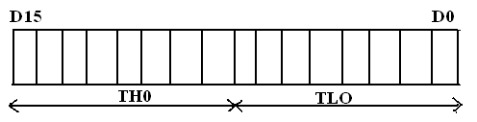
TIMER 0
The Timer 0 is a 16-bit register and can be treated as two 8-bit registers (TL0 & TH0) and these registers can be accessed similar to any other registers like A,B or R1,R2,R3 etc…
Ex : The instruction Mov TL0,#07 moves the value 07 into lower byte of Timer0.
Similarly Mov R5,TH0 saves the contents of TH0 in the R5 register.

Slide 11
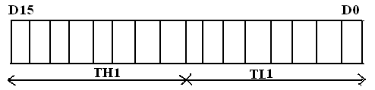
TIMER 1
The Timer 1 is also a 16-bit register and can be treated as two 8-bit registers (TL1 & TH1) and these registers can be accessed similar to any other registers like A,B or R1,R2,R3 etc…
Ex : The instruction MOV TL1,#05 moves the value 05 into lower byte of Timer1.
Similarly MOV R0,TH1 saves the contents of TH1 in the R0 register

Slide 12
Timer Mode Operation (from book)
Timer Mode 0
Timer Mode 1
Timer Mode 2
Timer Mode 3

Slide 13
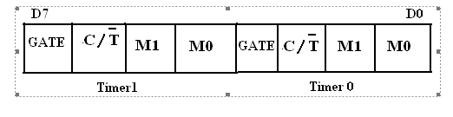
TMOD Register
The various operating modes of both the timers T0 and T1 are set by an 8-bit register called TMOD register. In this TMOD register the lower 4-bits are meant for Timer 0 and the higher 4-bits are meant for Timer1.

Slide 14
TMOD Register
GATE: This bit is used to start or stop the timers by hardware. When GATE = 1 ,the timers can be started / stopped by the external sources. When GATE = 0, the timers can be started or stopped by software instructions like SETB TR0 or SETB TR1
C/T (clock/Timer) : This bit decides whether the timer is used as delay generator or event counter. When C/T = 0 ,the Timer is used as delay generator and if C/T = 1 the timer is used as an event counter. The clock source for the time delay is the crystal frequency of 8051.

Slide 15
TMOD Register
M1,M0 (Mode) : These two bits are the timer mode bits. The timers of the 8051 can be configured in four modes.Mode0, Mode1, Mode2 and Mode3.The selection and operation of the modes is shown below.
S.No | M0 | M1 | Mode | Operation
1 | 0 | 0 | 0 | 13-bit Timer mode Use the THX register as an 8-bit counter and the TLX as a 5-bit counter.
2 | 0 | 1 | 1 | 16-bit Timer mode. Use the THX register as an 8-bit counter and the TLX as an 8-bit counter.
3 | 1 | 0 | 2 | 8-bit auto reload. THX contains a value that is to be loaded into TLX each time it overflows. Use only TLX register as an 8 bit counter.
4 | 1 | 1 | 3 | Split timer mode. In this mode, Timer 0 is configured as 2 separate 8 bit timers and Timer 1 is stopped

Slide 16
Addressing Modes
The way in which the instruction is specified.
Immediate
Register
Direct
Register Indirect
Indexed

Slide 17
Immediate Addressing Mode
Immediate Data is specified in the instruction itself
Egs:
MOV A, #65H
MOV A, #’A’
MOV R6, #65H
MOV DPTR, #2343H
MOV P1, #65H

Slide 18
Register Addressing Mode
MOV Rn, A ;n=0,..,7
ADD A, Rn
MOV DPTR, R6

Slide 19
Direct Addressing Mode
Although the entire of 128 bytes of RAM can be accessed using direct addressing mode, it is most often used to access RAM loc. 30 – 7FH.
MOV R0, 40H
MOV 56H, A
MOV A, 4 ; ≡ MOV A, R4
MOV 6, 2 ; copy R2 to R6
; MOV R6,R2 is invalid !

Slide 20
Register Indirect Addressing Mode
In this mode, register is used as a pointer to the data.
MOV A, @R0 ; move content of RAM location where address is held by R0 into A
MOV @R1, B
In other word, the content of register R0 or R1 is sources or target in MOV, ADD and SUB instructions.

Slide 21
Indexed Addressing Mode And On-Chip ROM Access
This mode is widely used in accessing data elements of look-up table entries located in the program (code) space ROM at the 8051
MOVC A, @A+DPTR
A= content of address A + DPTR from ROM
Note:
Because the data elements are stored in the program (code ) space ROM of the 8051, it uses the instruction MOVC instead of MOV. The “C” means code.

Slide 22
8051- SERIAL COMMUNICATION

Slide 23
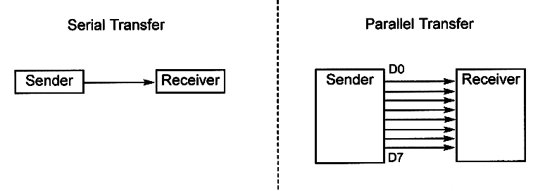
Basics of serial communication

Slide 24
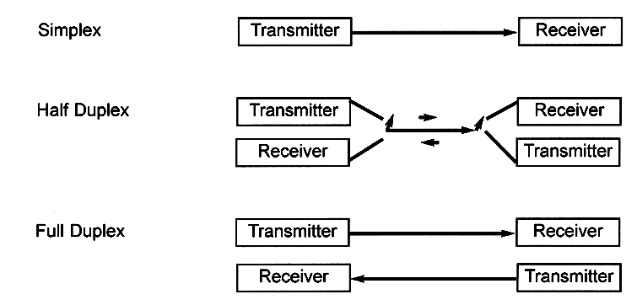
Types of Serial communications

Slide 25
Differences between Serial data transfer and Parallel data transfer
S.No | Serial Communication | Parallel Communication
1 | Data is transmitted bit after the bit in a single line | Data is transmitted simultaneously through group of lines(Bus)
2 | Data congestion takes place | No, Data congestion
3 | Low speed transmission | High speed transmission
4 | Implementation of serial links is not an easy task. | Parallel data links are easily implemented in hardware
5. | In terms of transmission channel costs such as data bus cable length, data bus buffers, interface connectors, it is less expensive | It is more expensive
6 | No , crosstalk problem | Crosstalk creates interference between the parallel lines.
7 | No effect of inter symbol interference and noise | Parallel ports suffer extremely from inter-symbol interference (ISI) and noise, and therefore the data can be corrupted over long distances.
8 | The bandwidth of serial wires is much higher. | The bandwidth of parallel wires is much lower.
9 | Serial interface is more flexible to upgrade , without changing the hardware | Parallel data transfer mechanism rely on hardware resources and hence not flexible to upgrade.
10 | Serial communication work effectively even at high frequencies. | Parallel buses are hard to run at high frequencies.

Slide 26

SERIAL COMMUNICATION IN 8051 MICROCONTROLLER
The 8051 has two pins for transferring and receiving data by serial communication.
These two pins are part of the Port3(P3.0 &P3.1).
Serial communication is controlled by an 8-bit register called SCON register, it is a bit addressable register.
SCON (Serial control) register :
The SCON register is an 8-bit register used to program the start bit, stop bit, and data bits of data framing, among other things.

Slide 27
SCON (Serial control) register
SM0 | SCON.7 | Serial port mode selector
SM1 | SCON.6 | Serial port mode selector
SM2 | SCON.5 | Used for multiprocessor mode communication (not applicable for 8051)
REN | SCON.4 | Receive enable. Set or cleared by making this bit either 1 or 0 foe enable /disable reception.
TB8 | SCON.3 | 9th data bit transmitted in modes 2 and 3 (not widely used)
RB8 | SCON.2 | 9th data bit received in modes 2 and 3.it is not used in mode 0 & mode 1.If SM2 = 0 RB8 is the stop bit . (not widely used)
TI | SCON.1 | Transmit interrupt flag
RI | SCON.0 | Receive interrupt flag.

Slide 28

SBUF register
SBUF is an 8-bit register used solely for serial communication in the 8051.
For a byte of data to be transferred via the TxD line, it must be placed in the SBUF register.
Similarly, SBUF holds the byte of data when it is received by the 8051 ‘s RxD line.
SBUF can be accessed like any other register in the 8051.
Look at the following examples of how this register is accessed:

Slide 29
SBUF register
The moment a byte is written into SBUF, it is framed with the start and stop bits and transferred serially via the TxD pin.
Similarly, when the bits are received serially via RxD, the 8051 deframes it by eliminating the stop and start bits, making a byte out of the data received, and then placing it in the SBUF.

Slide 30
SCON (Serial control) register
SM0, SM1 : These two bits of SCON register determine the framing of data by specifying the number of bits per character and start bit and stop bits. There are 4 serial modes.
SM0 SM1
0 0 : Serial Mode 0
0 1 : Serial Mode 1
1 0 : Serial Mode 2
1 1 : Serial Mode 3

Slide 31
SCON (Serial control) register
In the SCON register, when serial mode 1 is chosen, the data framing is 8 bits, 1 stop bit, and 1 start bit, which makes it compatible with the COM port of IBM/compatible PCs.
In serial mode 1, for each character a total of 10 bits are transferred, where the first bit is the start bit, followed by 8 bits of data, and finally 1 stop bit.

Slide 32
SCON (Serial control) register
REN (Receive Enable) also referred as SCON.4. When it is high, it allows the 8051 to receive data on the RxD pin. So to receive and transfer data REN must be set to 1.When REN=0,the receiver is disabled. This is achieved as below
SETB SCON.4
& CLR SCON.4

Slide 33
SCON (Serial control) register
TI (Transmit interrupt) is the D1 bit of SCON register. When 8051 finishes the transfer of 8-bit character, it raises the TI flag to indicate that it is ready to transfer another byte. The TI bit is raised at the beginning of the stop bit.
RI (Receive interrupt) is the D0 bit of the SCON register. When the 8051 receives data serially ,via RxD, it gets rid of the start and stop bits and places the byte in the SBUF register. Then it raises the RI flag bit to indicate that a byte has been received and should be picked up before it is lost. RI is raised halfway through the stop bit.

Slide 34
Thank You

